Slide 1
What is Infrastructure as Code? An Introduction & Live Workshop
07/25/2022
Nashville Innovation and Delivery Center (NIDC
Mitchell Ciupak

Slide 2
Agenda
Introduction
What is Infrastructure as Code?
IaC Tools
Infrastructure Lifecycle
What is GitOps?
What is Terraform?
Workshop
GitHub and Contribution Rules
Using Terraform
Using Terraform Plugins

Slide 3
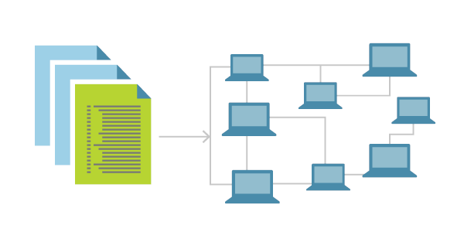
What is IaC (Infrastructure as Code)?
The Problem w/ Manual Configuration
Manually configuring your cloud infrastructure allow you to easily start using new service offerings to quickly prototype architectures however it comes with many downsides:
It is easy to mis-configure a service through human error.
It is difficult to manage or move the expected state of your configuration.
It is difficult to transfer knowledge of the configurations to other team members.
Infrastructure as Code (IaC)
You simply write a configuration script to automate the creation, updates, and destruction of your cloud infrastructure.
IaC is a blueprint for your infrastructure.
IaC can be easily shared, versioned, and acts as an inventory for your cloud infrastructure.

Slide 4
IaC (Infrastructure as Code) Tools
Popular Infrastructure as Code Tools
Declarative v. Imperative
There are two types of these tools. Declarative and Imperative. Declarative tools are explicit, largely non-conditional, and are typically written in JSON, YAML, or XML. Imperative tools tie into programming languages and offer the ability to be nested in conditionals or loops of the language, making them prone to misconfiguration.
Declarative Examples
Azure Blueprints
AWS CloudFormation
GCP Cloud Deployment Manager
Terraform
Imperative Examples
AWS CKD
More About Terraform
Terraform is a declarative IaC tool with its own language that supports loops, complex data structures, and dynamic blocks to a limited functional capacity. Offering the best of both worlds.
Notes:
def Introduce_InfraLifecycles(:
III. Infrastructure Lifecycle
a. What is an Infrastructure's Lifecycle?
A number of clearly defined and distinct work phases which are used by DevOps Engineers to plan, design, build, test, deliver, maintain, and retire cloud infrastucture.
b. An Infrastructure Lifecycle Example
------REMOVED FOR TIME--------
return
def Introduce_InfraTools(:
# IV. Provisioning v. Deployment v. Ochestration
# a. Provisioning
# b. Deployment
# c. Ochestration
return
def Introduce_GitOps(:
# V. What is GitOps?
return
def Introduce_Terraform(:
# VI. Terraform Re-Intro
# a. What is Terraform Again?
# b. Terraform Lifecycle
# c. Change Automation
# d. Execution Plans
# e. Resource Graphs
# f. Use Cases
return
def Introduction(:
Introduce_IaCBasic(
Introduce_IaCTools(
Introduce_InfraLifecycles(
Introduce_InfraTools(
Introduce_GitOps(
Introduce_Terraform(
def Introduce_TerraformSpotifyPlugin(:
return
def Introduce_ContributionRules(:
return
def Workshop(:
Introduce_Terraform(
Introduce_TerraformSpotifyPlugin(
Introduce_ContributionRules(
def Agenda(:
Introduction(
Workshop(
if __name__ == __main__:
Agenda(

Slide 5
Infrastructure Management Tools
Provisioning v. Deployment v. Orchestration
Provisioning
Deployment
Orchestration
Notes:
def Introduce_GitOps(:
# V. What is GitOps?
return
def Introduce_Terraform(:
# VI. Terraform Re-Intro
# a. What is Terraform Again?
# b. Terraform Lifecycle
# c. Change Automation
# d. Execution Plans
# e. Resource Graphs
# f. Use Cases
return
def Introduction(:
Introduce_IaCBasic(
Introduce_IaCTools(
Introduce_InfraLifecycles(
Introduce_InfraTools(
Introduce_GitOps(
Introduce_Terraform(
def Introduce_TerraformSpotifyPlugin(:
return
def Introduce_ContributionRules(:
return
def Workshop(:
Introduce_Terraform(
Introduce_TerraformSpotifyPlugin(
Introduce_ContributionRules(
def Agenda(:
Introduction(
Workshop(
if __name__ == __main__:
Agenda(

Slide 6
What is GitOps?
Provisioning v. Deployment v. Orchestration
Provisioning
Deployment
Orchestration
Notes:
def Introduce_GitOps(:
# V. What is GitOps?
return
def Introduce_Terraform(:
# VI. Terraform Re-Intro
# a. What is Terraform Again?
# b. Terraform Lifecycle
# c. Change Automation
# d. Execution Plans
# e. Resource Graphs
# f. Use Cases
return
def Introduction(:
Introduce_IaCBasic(
Introduce_IaCTools(
Introduce_InfraLifecycles(
Introduce_InfraTools(
Introduce_GitOps(
Introduce_Terraform(
def Introduce_TerraformSpotifyPlugin(:
return
def Introduce_ContributionRules(:
return
def Workshop(:
Introduce_Terraform(
Introduce_TerraformSpotifyPlugin(
Introduce_ContributionRules(
def Agenda(:
Introduction(
Workshop(
if __name__ == __main__:
Agenda(

Slide 7
Terraform – A Deeper Dive
Terraform Re-Introduction
Terraform is a declarative IaC tool
Also…
Terraform Lifecycle
Change Automation
Execution Plans
Resource Graphs
Use Cases

Slide 8
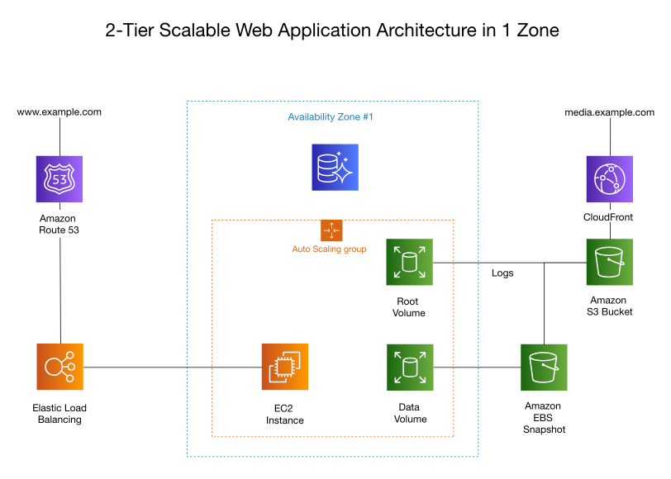

Slide 9
Workshop

Slide 10
Let’s all get on the same page and workshop demo. What we are doing
Provisioning v. Deployment v. Orchestration
Provisioning
Deployment
Orchestration
Notes:
def Introduce_GitOps(:
# V. What is GitOps?
return
def Introduce_Terraform(:
# VI. Terraform Re-Intro
# a. What is Terraform Again?
# b. Terraform Lifecycle
# c. Change Automation
# d. Execution Plans
# e. Resource Graphs
# f. Use Cases
return
def Introduction(:
Introduce_IaCBasic(
Introduce_IaCTools(
Introduce_InfraLifecycles(
Introduce_InfraTools(
Introduce_GitOps(
Introduce_Terraform(
def Introduce_TerraformSpotifyPlugin(:
return
def Introduce_ContributionRules(:
return
def Workshop(:
Introduce_Terraform(
Introduce_TerraformSpotifyPlugin(
Introduce_ContributionRules(
def Agenda(:
Introduction(
Workshop(
if __name__ == __main__:
Agenda(

Slide 11
Lets talk about how to make a PR
Provisioning v. Deployment v. Orchestration
Provisioning
Deployment
Orchestration
Notes:
def Introduce_GitOps(:
# V. What is GitOps?
return
def Introduce_Terraform(:
# VI. Terraform Re-Intro
# a. What is Terraform Again?
# b. Terraform Lifecycle
# c. Change Automation
# d. Execution Plans
# e. Resource Graphs
# f. Use Cases
return
def Introduction(:
Introduce_IaCBasic(
Introduce_IaCTools(
Introduce_InfraLifecycles(
Introduce_InfraTools(
Introduce_GitOps(
Introduce_Terraform(
def Introduce_TerraformSpotifyPlugin(:
return
def Introduce_ContributionRules(:
return
def Workshop(:
Introduce_Terraform(
Introduce_TerraformSpotifyPlugin(
Introduce_ContributionRules(
def Agenda(:
Introduction(
Workshop(
if __name__ == __main__:
Agenda(

Slide 12
Example of what to do
Provisioning v. Deployment v. Orchestration
Provisioning
Deployment
Orchestration
Notes:
def Introduce_GitOps(:
# V. What is GitOps?
return
def Introduce_Terraform(:
# VI. Terraform Re-Intro
# a. What is Terraform Again?
# b. Terraform Lifecycle
# c. Change Automation
# d. Execution Plans
# e. Resource Graphs
# f. Use Cases
return
def Introduction(:
Introduce_IaCBasic(
Introduce_IaCTools(
Introduce_InfraLifecycles(
Introduce_InfraTools(
Introduce_GitOps(
Introduce_Terraform(
def Introduce_TerraformSpotifyPlugin(:
return
def Introduce_ContributionRules(:
return
def Workshop(:
Introduce_Terraform(
Introduce_TerraformSpotifyPlugin(
Introduce_ContributionRules(
def Agenda(:
Introduction(
Workshop(
if __name__ == __main__:
Agenda(

Slide 13
Lets do it
Provisioning v. Deployment v. Orchestration
Provisioning
Deployment
Orchestration
Notes:
def Introduce_GitOps(:
# V. What is GitOps?
return
def Introduce_Terraform(:
# VI. Terraform Re-Intro
# a. What is Terraform Again?
# b. Terraform Lifecycle
# c. Change Automation
# d. Execution Plans
# e. Resource Graphs
# f. Use Cases
return
def Introduction(:
Introduce_IaCBasic(
Introduce_IaCTools(
Introduce_InfraLifecycles(
Introduce_InfraTools(
Introduce_GitOps(
Introduce_Terraform(
def Introduce_TerraformSpotifyPlugin(:
return
def Introduce_ContributionRules(:
return
def Workshop(:
Introduce_Terraform(
Introduce_TerraformSpotifyPlugin(
Introduce_ContributionRules(
def Agenda(:
Introduction(
Workshop(
if __name__ == __main__:
Agenda(

